Slide 1
Intel® Xeon® Processor E5 Family The Business Case
[Presenter:]
[Title:]
[Date:]

Slide 2
Presentation Notes
Internal use only – Please remove before forwarding or presenting
About this presentation:
Intel’s latest addition to its processor products is the Intel® Xeon® processor E5 family, which addresses a broad array of IT usages, including enterprise infrastructure, workstations, public and private cloud installations, storage systems, and high-performance computing, as well as some embedded devices.
This new family of products is the successor to the Intel Xeon processor 5600 and 5500 series, which are among the most popular enterprise technology products of all time.
Adding the Intel Xeon processor E5 family to your data center is a smart, cost-effective move that can enhance IT’s ability to respond to the business and provide new service models in today’s challenging IT environment.
Audience: IT executives
Region: Worldwide
Usage Guidelines:
This presentation is meant to help you make the business case for adding Intel Xeon processor E5 family servers to your data center(s).
The slides are designed to drop into a larger presentation or stand alone. Use the slides most appropriate for your situation.
Use the updated ROI tool (intel.com/go/xeonestimator) to customize your presentation with cost data specific to your organization.

Slide 3
Legal Disclaimers
All products, computer systems, dates, and figures specified are preliminary, based on current expectations, and are subject to change without notice.
Intel® processor numbers are not a measure of performance. Processor numbers differentiate features within each processor family, not across different processor families. Go to intel.com/products/processor_number.
Intel processors, chipsets, and desktop boards may contain design defects or errors known as errata, which may cause the product to deviate from published specifications. Current characterized errata are available on request.
Intel Virtualization Technology requires a computer system with an enabled Intel processor, a BIOS, and virtual machine monitor (VMM). Functionality, performance, or other benefits will vary depending on hardware and software configurations. Software applications may not be compatible with all operating systems. Consult your PC manufacturer. For more information, visit intel.com/go/virtualization.
No computer system can provide absolute security under all conditions. Intel Trusted Execution Technology (Intel TXT) requires a computer system with Intel Virtualization Technology, an Intel TXT–enabled processor, a chipset, a BIOS, Authenticated Code Modules, and an Intel TXT–compatible measured launched environment (MLE). Intel TXT also requires the system to contain a TPM v1.s. For more information, visit intel.com/technology/security.
Intel Turbo Boost Technology Requires a system with Intel Turbo Boost Technology. Intel Turbo Boost Technology and Intel Turbo Boost Technology 2.0 are only available on select Intel processors. Consult your PC manufacturer. Performance varies depending on hardware, software, and system configuration. For more information, visit intel.com/go/turbo.
Intel Advanced Encryption Standard New Instructions (Intel AES-NI) requires a computer system with an AES-NI-enabled processor, as well as non-Intel software to execute the instructions in the correct sequence. AES-NI is available on select Intel processors. For availability, consult your reseller or system manufacturer. For more information, see software.intel.com/en-us/articles/intel-advanced-encryption-standard-instructions-aes-ni/.
Intel Node Manager: Requires servers with Intel Node Manager and enabled monitoring or management software, such as Intel Data Center Manager.
INFORMATION IN THIS DOCUMENT IS PROVIDED “AS IS.” NO LICENSE, EXPRESS OR IMPLIED, BY ESTOPPEL OR OTHERWISE, TO ANY INTELLECTUAL PROPERTY RIGHTS IS GRANTED BY THIS DOCUMENT. INTEL ASSUMES NO LIABILITY WHATSOEVER, AND INTEL DISCLAIMS ANY EXPRESS OR IMPLIED WARRANTY RELATING TO THIS INFORMATION, INCLUDING LIABILITY OR WARRANTIES RELATING TO FITNESS FOR A PARTICULAR PURPOSE, MERCHANTABILITY, OR INFRINGEMENT OF ANY PATENT, COPYRIGHT, OR OTHER INTELLECTUAL PROPERTY RIGHT.
Intel, the Intel logo, Intel Inside, the Intel Inside logo, Intel Sponsors of Tomorrow., the Intel Sponsors of Tomorrow. logo, Xeon, and Xeon Inside are trademarks or registered trademarks of Intel Corporation or its subsidiaries in the United States and other countries. Other names and brands may be claimed as the property of others.
Copyright © 2012 Intel Corporation. All rights reserved.

Slide 4
Legal Disclaimers: Performance
Performance tests and ratings are measured using specific computer systems and/or components and reflect the approximate performance of Intel products as measured by those tests. Any difference in system hardware or software design or configuration may affect actual performance. Buyers should consult other sources of information to evaluate the performance of systems or components they are considering purchasing. For more information on performance tests and on the performance of Intel products, go to intel.com/performance/resources/benchmark_limitations.htm.
Intel does not control or audit the design or implementation of third-party benchmarks or web sites referenced in this document. Intel encourages all of its customers to visit the referenced web sites or others where similar performance benchmarks are reported and confirm whether the referenced benchmarks are accurate and reflect performance of systems available for purchase.
Relative performance is calculated by assigning a baseline value of 1.0 to one benchmark result, and then dividing the actual benchmark result for the baseline platform into each of the specific benchmark results of each of the other platforms and assigning them a relative performance number that correlates with the performance improvements reported.
SPECfp is a trademark of the Standard Performance Evaluation Corporation. See spec.org for more information.
TPC Benchmark is a trademark of the Transaction Processing Council. See tpc.org for more information.
Software and workloads used in performance tests may have been optimized for performance only on Intel microprocessors. Performance tests such as SYSmark* and MobileMark* are measured using specific computer systems, components, software, operations, and functions. Any change to any of those factors may cause the results to vary. You should consult other information and performance tests to assist you in fully evaluating your contemplated purchases, including the performance of that product when combined with other products.

Slide 5
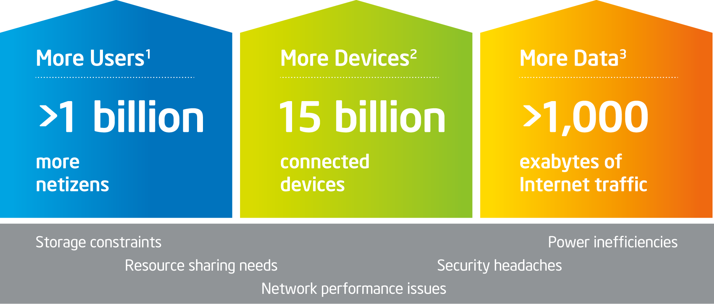
Next-Generation Data Center IT Must Do More with Less
Escalating demands on IT drive need for the best combination of performance, efficiency, and cost
1 IDC. “Server Workloads Forecast” (2009).
2 IDC. “The Internet Reaches Late Adolescence” (December 2009, extrapolation by Intel for 2015). ECG. “Worldwide Device Estimates Year 2020―Intel One Smart Network Work” forecast.
3 Source: cisco.com/assets/cdc_content_elements/networking_solutions/service_provider/visual_networking_ip_traffic_chart.html, extrapolated to 2015
Notes:
Key Points: [Sets context] Resource Sharing Needs
IT facing growing demand of users, devices and data—but is faced with ever tighter budgets.
New service models are putting extreme pressures on data center infrastructure with regard to performance, storage, networking, security, and power management.
Despite strained budgets, IT must create new, innovative service models to better serve the business.
Notes:
In the next five years, more than a billion people will connect to the Internet (total of 2.5B) with an estimated 15 billion connected devices. The volume of digital, unstructured data is exploding: visual data growth estimated to expand more than 10 times in size, increasing the data footprint across the Internet to greater than 1,000 exabytes!
These are exciting times. We are facing significant challenges to the data center—but also opportunities to deliver new, innovative services that support business goals and strengthen our business in the marketplace. We’ve already started moving in this direction with initiative(s) to [describe your recent and ongoing data center and other IT initiatives].
But the pressures on the data center pose some daunting infrastructure challenges in terms of efficiency, security, and resource capability that need to be addressed—and all within our budget constraints:
Storage constraints: Explosive growth of unstructured data strains storage capacity and puts increased demand on networks.
Network performance issues: Bottlenecks from increased network and storage traffic as well as greater virtual machine (VM) density cause network latency, slowing everything down.
New security headaches: Dynamic virtualization, multitenancy, and automation create new security headaches and demand a different approach to protecting infrastructure.
Resource sharing: Lack of interoperability across server, storage, and networking infrastructure.
Power inefficiencies: Inefficiencies risk potential outages, pressure budgets, and undermine “green” computing efforts.
Conclusion: Escalating demands on IT drive the need for the best combination of performance, efficiency, and cost.

Slide 6
Next-Generation Data Center Intel® Xeon® Processor E5
Built-in performance and capabilities to support innovation such as cloud service delivery and high-performance computing
Significant performance gains
Improved networking
Scalable and optimized storage
Data and infrastructure protection
Optimized power
Notes:
Key points:
The Intel® Xeon® processor E5 family is designed to be at the heart of today’s data centers. It provides the flexibility and efficiency required to address today’s challenges with headroom for the future.
The new processor combines the best combination of performance, built-in capabilities, and cost-effectiveness upon which to build our next-generation data center, meet our diverse needs, and drive value back into the organization.
Notes:
Intel has released the Intel Xeon processor E5 family, the successor to the Intel Xeon processor 5600 and 5500 series. This processor is designed to be at the heart of a next-generation data center and can address all of the challenges to data center infrastructure I just described—with room to spare. The performance and technology advancements in the Intel Xeon processor E5 family can help us future proof our data center investment with technology we can build on as we evolve new service models to support the business.
With the Intel Xeon processor E5 family, everything we need is built into the silicon. We can address network I/O issues. We can scale networking capabilities and storage to support new service models, such as cloud and high-performance computing. We can also lower the risk of a breach in our system with a powerful layer of protection for data and infrastructure. And we can optimize power at all levels of the data center—not only saving costs, but balancing power loads better for greater efficiency.

Slide 7
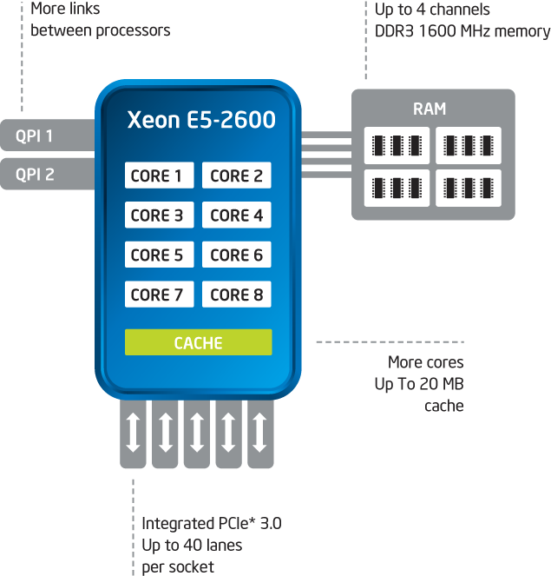
Next-Generation Data Center Stepped-Up Server Performance
More power and faster connections
Up to 80% raw performance boost vs. prior generations⁴ at consistent power level
Intel® Integrated I/O cuts latency⁵ while adding capacity and bandwidth
Adapts to workload spikes with Intel Turbo Boost Technology 2.0
Dramatically reduces compute time with Intel Advanced Vector Extensions for increased floating point operations per clock up to 2X⁶
4 Source: Performance comparison using best publications of SPECfp*_rate_base2006 benchmark available as of March 6, 2012. Score of 271 published on prior-generation 2S Intel Xeon processor X5690–based platform. Score of 488 published on new 2S Intel Xeon processor E5-2690–based platform. For additional details, please visit spec.org.
5 Intel measurements of average time for an I/O device read to local system memory under idle conditions. Improvement compares Intel Xeon processor E5-2600 family vs. Intel Xeon processor 5600 series.
6 Performance comparison using Linpack benchmark. See backup for configuration details. For more legal information on performance forecasts, go to intel.com/performance.
Notes:
Key points:
The Intel® Xeon® processor E5 family provides a significant boost to performance over previous generations—up to 80%.
Performance boosts result from physical improvements to the chip and built-in adaptability, intelligence, and integrated support for PCI Express 3.0 and SAS storage.
Notes:
The Intel Xeon processor E5 family provides a significant boost to performance―up to 80% more performance over previous generations across a range of workloads. Physical changes include more cores, more memory, more integration, and more bandwidth. Higher bandwidth is supported through the platform with additional speed through Intel QuickPath Interconnection (Intel QPI) (8.0 gigatransfers per second), more links between processors, support for DDR3-1600 memory, and the first enterprise support for Peripheral Component Interconnect Express (PCIe) 3.0.
The processor improves I/O and reduces latency up to 30% with Intel Integrated I/O, and support for PCI Express 3.0 and SAS storage is built directly into the silicon, making for faster connections. [Describe bandwidth and latency problems you may have had in your own data center and how this can help.]
The chip is also intelligent and adaptive. Intel Turbo Boost Technology—now in its second release—allows the processor to increase frequency at the operating system’s request to handle workload spikes as well as shift power across the processor. Plus, with Intel Advanced Vector Extensions, the processor supports more efficient instructions and can dramatically reduce compute time by increasing floating point operations per clock up to 2X for technical, financial, scientific, and content creation applications. [Describe performance issues related to the demands of specific workloads in your own data center.]

Slide 8
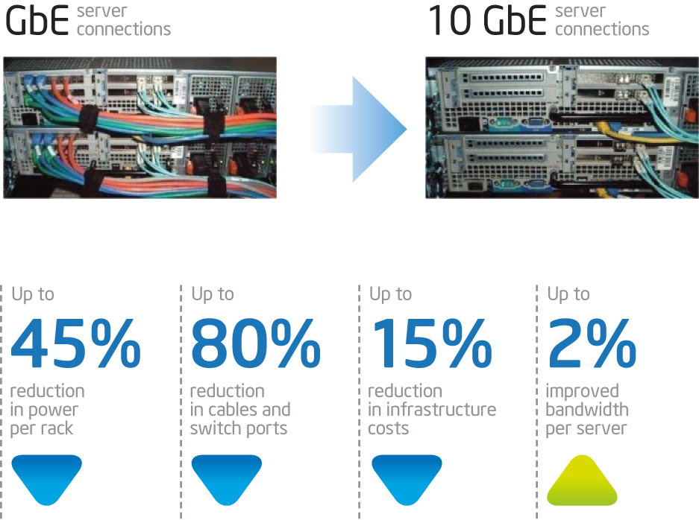
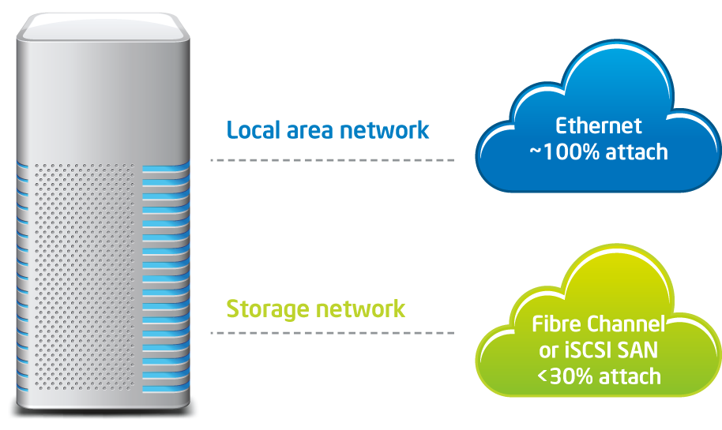
Next-Generation Data Center Unified Networking
Simplified network infrastructure
Consolidate⁷ multiple connections
Unify network and storage traffic⁸
7 Ethernet consolidation source: Intel 10 GbE ROI Calculator. This ROI calculator is a cost comparison for a highly virtualized solution, using multiple 1 GbE connections, versus a dual-port 10 GbE implementation: event-management-online.de/LAD/calculator.aspx
8 Up to 2.3x I/O performance is 1S WSM vs. 1S SNB data for L2 forwarding test using 8x10 GbE ports.
Notes:
Key Points:
The Intel® Xeon® processor E5 family supports 10 GbE solutions, which can simplify your network infrastructure by reducing power, improving bandwidth, and reducing cabling complexity.
You can further simplify your network by unifying different types of traffic onto a single, low-cost, high-bandwidth interconnect.
Notes:
This new Intel processor is the first to support integrated 10 GbE solutions on a mainstream server, making this an excellent time to accelerate our transition to 10 GbE. Intel 10 GbE can reduce cost and power for the network. Using Intel Virtualization Technology, we could combine multiple smaller Ethernet ports onto a single high-speed 10 GbE connection that reduces the number of ports—and hence the power and cabling costs of all those ports—in addition to providing more total bandwidth.
Intel 10 GbE network interface cards (NICs) are designed to take advantage of the benefits of Intel Data Direct I/O, another technology built into the Intel Xeon processor E5 family. Intel Data Direct I/O builds on Intel Integrated I/O by intelligently directing I/O packets to the processor cache and skipping a trip to main system memory. The I/O controller, now integrated onto the processor, dynamically determines the best path for all I/O traffic types based on overall system utilization. This can increase transactions per second up to 130% compared to previous generations. If memory is not being utilized, it can stay in low power state, reducing operating costs even while improving performance. Overall, Intel Data Direct I/O can significantly improve performance.
When you extend the discussion of 10 GbE to consolidating different traffic types on a single fabric, we’re talking significant additional infrastructure simplification. Data traffic is predominantly Ethernet based, since every server has Ethernet connectivity to the LAN. Data is increasingly being stored in storage area networks, or SANs. SANs can be purpose-built over a Fibre Channel technology or can be built over an Ethernet network using iSCSI.
Both types of networks have Ethernet in common, but until now we couldn’t move LAN and storage data over a single Ethernet network because of the limited bandwidth of a GbE network. But with the advent of 10 GbE, there is enough bandwidth to have a truly unified and single network. The benefits of such a network will be simplification, lower TCO due to infrastructure consolidation, and high flexibility to scale for future needs or add new services.

Slide 9
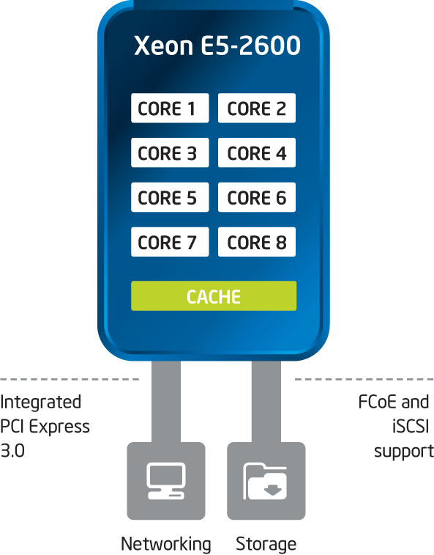
Next-Generation Data Center Optimized Storage
Scale out, optimize capacity, and balance storage
Fully capable storage server
Massive scalability
Open standards and interoperability
Enabled for intelligent storage solutions
Notes:
Key Points:
Intel® Xeon® processor E5 family–based servers can be used as fully capable converged storage servers, enabling scale-out storage with intelligent solutions built specifically for the cloud.
Notes:
Intel Xeon processor E5 family–based servers can be used as fully capable storage servers, enabling scale-out storage with intelligent solutions built specifically for the cloud.
In addition to providing increased compute power and performance, the processor enables massive, cost-effective scalability. Open standards and interoperability reduce reliance on expensive proprietary interfaces so that expanding capacity means adding nodes versus installing a discrete subsystem. The Intel Xeon processor E5 family supports Fibre Channel over Ethernet (FCoE) and Internet Small Computer System Interface (iSCSI) protocols for faster traffic over a converged network architecture.
The Intel Xeon processor E5 family provides the performance within storage solutions that enable next-generation capabilities like thin provisioning, automated tiering of data, data deduplication, and erasure coding/RAID over nodes. These solutions optimize capacity and balance storage I/O, as well as keep costs down.

Slide 10
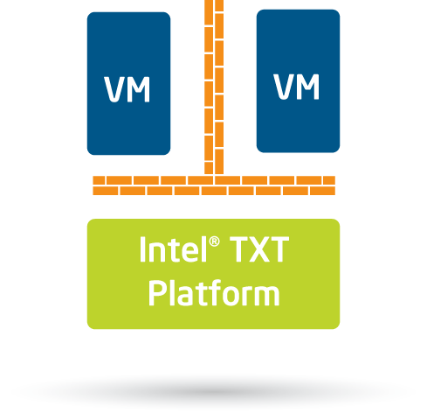
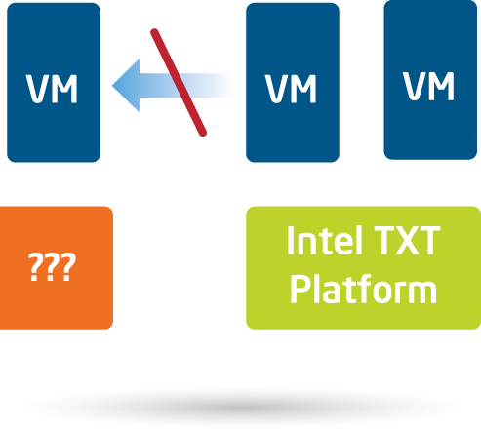
Next-Generation Data Center Faster, Stronger Security
Isolate
Enforce
Encrypt
Intel VT and Intel TXT protect VM isolation and provide a more secure platform launch
Intel TXT establishes a “trusted” foundation to control migration based on security policy
Intel AES-NI delivers built-in
encryption acceleration up to 10 times faster ⁹ for better data protection
9 AES-NI performance source: Testing with Oracle* Database Enterprise Edition 11.2.0.2 with Transparent Data Encryption (TDE) AES-256 shows as much as a 10x speedup when inserting one million rows 30 times into an empty table on the Intel Xeon® processor X5680 (3.33 GHz, 36 MB RAM) using Intel IPP routines, compared to the Intel Xeon processor X5560 (2.93 GHz, 36 MB RAM) without Intel IPP.
Notes:
Key Points:
Intel® Trusted Execution Technology (Intel TXT), Intel Virtualization Technology (Intel VT), and Intel Advanced Encryption Standard New Instructions (Intel AES-NI) are technologies already on all the latest Intel Xeon processors and now built into the Intel Xeon processor E5 family.
Intel TXT builds protection of data and platform into the chip; Intel AES-NI accelerates encryption without a performance tax.
Notes:
Intel TXT, Intel VT, and Intel AES-NI are technologies on all the latest Intel Xeon processors—and now they are built in to the Intel Xeon processor E5 family. Both technologies build security directly into the hardware, increasing protection of data and platform, so that we gain the ability to better and more efficiently protect both. Intel TXT and Intel VT work together to isolate workloads and help address an emerging class of threats—rootkit attacks. And faster and stronger encryption capabilities of Intel AES-NI help protect data in the case of a breach.
Intel TXT and Intel VT address a critical security need for all server deployments, especially virtualized and cloud-based use models. They work together to isolate workloads and system execution from launch through runtime to help reduce the attack surfaces of shared environments. Intel TXT also helps provide assurances of platform integrity through the enforcement of platform trust in which a “known good” software environment is in control of the platform. This enforcement of trust allows for new use models, such as creating pools of platforms with trusted hypervisors and using platform trust status to constrain migration of sensitive virtual machines (VMs) or workloads—allowing only moves to other trusted platforms. This raises the protection profile of critical data. Intel TXT also provides data to security information event management (SIEM) solutions, easing compliance and audit efforts.
Intel AES-NI is a set of instructions for encrypting data. There are seven new instructions in the Intel Xeon 5600 series processor that target some of the more complex and compute-expensive encryption, decryption, key expansion, and multiplication steps that enhance the performance and efficiency of these operations. These instructions can accelerate encryption up to 10X―dramatically reducing any performance penalties from encryption and therefore making it more usable and encouraging pervasive data encryption.

Slide 11
Next-Generation Data Center Optimized Power
Power and efficiency management—
at the server, rack, zone, and data center levels
Monitor
Track actual power usage
directly from the server
Limit
Restrict maximum node
power to increase rack
density with confidence
Optimize
Use data and power limiting to place workloads for maximum efficiency
Survive
Automatically reduce
power to extend operations
during power events
Notes:
Key Points:
Intel® Node Manager provides tools to control system power, enabling much greater rack density.
Intel Data Center Manager builds on this control to enable data center–wide policies
Notes:
Better power management is one way to reduce operational costs in the data center—a significant budget item. As part of overall performance gains, the Intel Xeon® processor E5 family provides energy performance gains per watt. Plus, the chip’s microarchitecture is designed to emphasize power reductions in both active and idle states.
To improve idle power as well as best match power draw to processor use, the Intel Xeon processor E5 family scales the memory, cache, I/O, and other processor functions to support the compute cores. That way the system only consumes power to provide the highest possible bandwidth when the cores are in high demand. With less demand, the processor shifts down to a high-efficiency, lower-power state.
The new processors also take advantage of other power technologies from Intel, such as integrated power gates, and have added in greater awareness of the running average power level (RAPL). This provides greater control and adaptability to power management tools.
Intel Node Manager, power software built in to the Intel Xeon processor E5 family, and Intel Data Center Manager, a software development kit (SDK) that ISVs and OEMs integrate into their management software, are additional solutions that can deliver power efficiency for real cost savings.
Intel Node Manager monitors each system’s power and thermal level and gives granular control of each system. Using a third-party console, we can set policy at the rack level to limit node power so that the systems in aggregate never exceed the rack’s power budget. Managing power consumption at the individual server level reduces overprovisioning of power and cooling to real usage conditions. Early adopters of Intel Node Manager have seen up to 40% improvements in rack density. Approximately 20 OEMs and original design manufacturers (ODMs) already support Intel Node Manager.
Beyond the rack level, Intel Data Center Manager, in partnership with third-party management consoles, allows for even more automated control via IT policies. Higher-level aggregation and control at the row or data center level allow IT to manage power to fit within the power and cooling resources available and optimize productivity by deterministically managing power at the server, rack, row, and data center levels. These tools also provide the instrumentation to enable power-based load balancing or load migration. During a power event, data center power is automatically reduced to extend operations and minimize potential damage.

Slide 12
Next-Generation Data Center Reduced Total Cost of Ownership
Simplified network infrastructure
Technical advancements since 2007
Intel® Turbo Boost Technology 2.0
Reduces hard workload spikes with higher frequencies
Intel AES-NI
Accelerates encryption
Intel Trusted Execution Technology
Defends against attacks during launch
Intel Advanced Vector Extensions
Increases FLOPS per clock
Intel Integrated I/O Reduces I/O latency
Intel Hyper-Threading
Doubles the number of threads per core
Intel Virtualization Technology
Enhances virtualization performance with new platform capabilities
Intel Node Manager 2.0
Maximizes operating efficiency with power monitoring and limiting
Intel Data Center Manager
Provides data to enable improved dynamic workload placement and migration
Intel QuickPath Interconnect
High-bandwidth processor interconnect delivers greater bandwidth
Integrated Power Gates
Enables idle cores to go to near zero power draw
Notes:
Key points:
The new technologies built in to the Intel® Xeon® processor E5 family combine the major hardware-based advancements made by Intel in a single processor.
This platform has everything we need, but we can utilize the technology on our own time frame—depending on our internal priorities.
Notes:
All of these new capabilities combine to offer a better processor that combines high performance, optimized I/O, flexible power management, and robust security to meet the growing demands on our IT infrastructure. Support for integrated 10 GbE solutions can have a positive impact on TCO through simplified infrastructure and greater flexibility to evolve innovative services in the future.
Performance and technology advances alone will help us recover costs in terms of the flexibility they give us to respond better to business—for the changes we already know we want to make now and for the possibilities they open to us in the future.

Slide 13
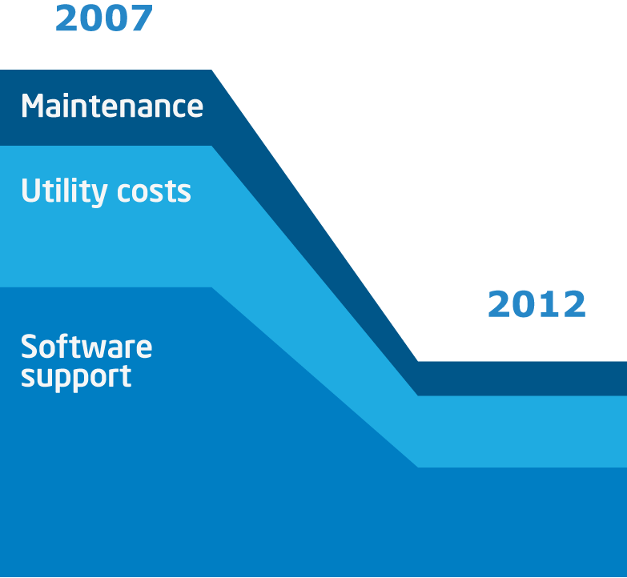
Next-Generation Data Center Reduced Total Cost of Ownership
Refresh and save
Reduced TCO up to 66%¹⁰
Power management and increased efficiency can significantly reduce the power required to deliver a set level of performance
Major performance gains every generation maximize output per software license potential savings over a system’s life
10 Based on an Intel savings estimator tool, available to everyone, that helps estimate the savings from installing a new system vs. leaving existing servers in place. Results may vary. Find out more and estimate your savings potential at intel.com/go/xeonestimator.
Notes:
Key points:
The Intel® Xeon® processor E5 family can reduce total cost of ownership by up to 66%.
Including the cost of acquiring a new server, the total cost of ownership of systems based on a new Intel Xeon processor E5-2600-based system is ~66% reduction over four years vs. leaving an aging system in place.
Notes:
How do these technologies impact the bottom line? Intel has created a tool, available to everyone, that helps estimate the savings from installing a new system vs. leaving existing servers in place. Based on this tool, Intel estimates ~66% reduction in total cost of ownership. Of course, our results may vary from that number based on our software licenses, the cost of power in our data center, and space constraints.
Industry analysts estimate that dual-socket servers are typically refreshed every three to five years with an average life of a bit over four years, and Intel’s own IT department has found that a four-year refresh cycle provides the best combination of value and cost savings to the organization. [Describe your organization’s server refresh schedule here.] Compared to quad-core systems from that time frame, Intel now offers processors that have improvements across a range of vectors―from improved system bandwidth with Intel QuickPath Interconnect, to Intel Integrated I/O, to adaptive performance with Intel Turbo Boost technology.
Intel’s technical advancements developed during the past five years are now combined in a single processor. Those built-in technologies combined with the dramatic performance improvements of Intel Xeon processor E5 family–based servers means that fewer systems can do more work—for lower operating expenses.
The power required to deliver a set level of performance is estimated to drop as much as 90%, which not only saves on the operating budget, but helps reduce your carbon footprint―an important means of achieving our “green” goals. A huge cost savings opportunity is around software licenses. Many of these charge on a per processor or per core basis, which means that being on the latest, highest- performance system can reduce the total number of licenses we need. Depending on the exact applications we use, savings can quickly repay the hardware cost of a new system.
This next slide shows the results of using the Intel tool to estimate cost savings from installing a new system vs. leaving existing servers in place.

Slide 14
Next-Generation Data Center Savings Potential
PLEASE READ BEFORE REMOVING AND REPLACING WITH YOUR RESULTS FROM THE INTEL ESTIMATOR TOOL:
The tool is an interactive tool that uses the information that you supply to provide an estimate of your possible IT costs and savings when replacing existing installed servers with Intel Xeon processor technology. The tool is intended to enable you to get a better understanding of how the purchase of systems with Intel Xeon processor technology, combined with a number of situation-specific variables (e.g., the number of platforms in your enterprise, the rate at which you upgrade or replace the platforms in your enterprise, the additional cost of servers with Intel Xeon processors charged by your OEM, the incremental per system configuration cost, additional ISV software license cost, additional ISV software installation cost, the number of employees that require training on Intel Xeon processor technology, or training each trainee will receive), might affect your future IT support cost and savings. The general accuracy of the estimate generated by the tool will depend on how closely the variables chosen by you match your actual circumstances.
The results generated or scenarios described in the tool are estimates and should only be used as a guide to evaluate the cost/benefit or feasibility of a future purchase of systems with Intel Xeon processors. The actual economic results realized as a result of a purchase of systems with Intel Xeon processors will vary, and there is no guarantee that you will actually realize the economic results forecast by the tool. There may be additional unaccounted-for costs related to the use and deployment of servers that are not or cannot be accounted for on this tool. Any estimate generated by the tool is not and should not be interpreted as either a promise of or contract for a given level of IT support cost and savings. Prior to purchasing any systems with Intel Xeon processors, you should consult with qualified IT professionals to ensure that any such purchases fit your particular circumstances. Intel does not and cannot guarantee the accuracy or reliability of the results generated by the tool or that you will actually realize any cost savings as forecast by the tool.
Results from intel.com/go/xeonestimator.
Notes:
Presenter Guidance:
Check the ROI calculator for Intel Xeon processors on Intel.com: intel.com/go/xeonestimator for an estimate of your exact savings potential.
Consider more than one scenario and then prepare one or two slides showing the results.
Key Points:
It’s important to look at our server refresh cycle and start planning to purchase Intel® Xeon® processor E5 family–based servers now.
Even outside of our server refresh cycle, the Intel Xeon processor E5 family drives significant value back into the organization for an attractive ROI and ongoing TCO.
Notes:
The gains in performance and technology advances we’ve talked about drive significant value back into the organization—even outside of our server refresh cycle—for an attractive ROI and ongoing TCO.
Add to that the potential to reap additional savings through adoption of 10 GbE networking and scale-out storage solutions, and our cost benefits will continue to grow.
Here are some numbers based on our data center situation that project our potential savings. [Consider one or more scenarios for your organization and prepare a slide showing potential savings for each.]

